Slide 1

Regional Sales Performance and Product Demand Analysis of Globalmart
Presented By
V.Sowmini

Slide 2
ABSTRACT
This project analyzes Globalmart’s sales and product trends using Power BI to drive data-driven decision-making. By processing 5,000+ records, an interactive dashboard was developed to track Regional Sales Performance and Product Demand.
A key highlight is the use of M-Language (Power Query) to create a custom "Performance Status" logic, automatically categorizing deals as Target Achieved, Below Target, or Lost. The final dashboard provides a strategic overview of revenue growth and category demand, transforming raw data into actionable business intelligence.

Slide 3
PROBLEM STATEMENT
In the highly competitive retail sector, Globalmart manages a vast and complex dataset of over 5,000 transactions across multiple regions and product categories. Despite having a wealth of data, the organization faces three critical challenges:
Lack of Visibility into Regional Variance: Management struggles to identify which specific regions are consistently meeting sales targets and which are underperforming in real-time.
Product Demand Misalignment: There is a gap in understanding which product categories drive the most volume versus those that generate the most revenue, leading to potential inventory imbalances.
Static Performance Tracking: Currently, the sales data is "static," making it difficult to instantly categorize "Successful" vs. "Failed" deals based on fluctuating corporate targets.

Slide 4
PROJECT OBJECTIVES
Performance Benchmarking: To evaluate actual sales revenue against pre-defined corporate targets to measure overall business success.
Regional Trend Analysis: To identify high-growth geographical regions and those requiring strategic sales intervention.
Product Demand Profiling: To analyze volume and revenue across categories to determine which products are driving the most market demand.
Automated Decision-Making: To implement a dynamic "Performance Status" logic using M-Language that replaces manual tracking with automated visual indicators.
Interactive Forecasting: To create a user-friendly dashboard that allows stakeholders to filter data by Team and Category for ls manual localized insights.

Slide 5



Order_ID
Order_Date
Region & Country
Sales_Rep & Team
Customer_ID & Segment
Product_Category & Product_Name
Stage
Units_Sold
Revenue
Target
Performance_Status
Dataset Name: GlobalMart Supermarket Sales Dataset
Data Source: Sourced from Kaggle
Dataset Name: GlobalMart Supermarket Sales Dataset
Total Records: 4938 Rows

Slide 6
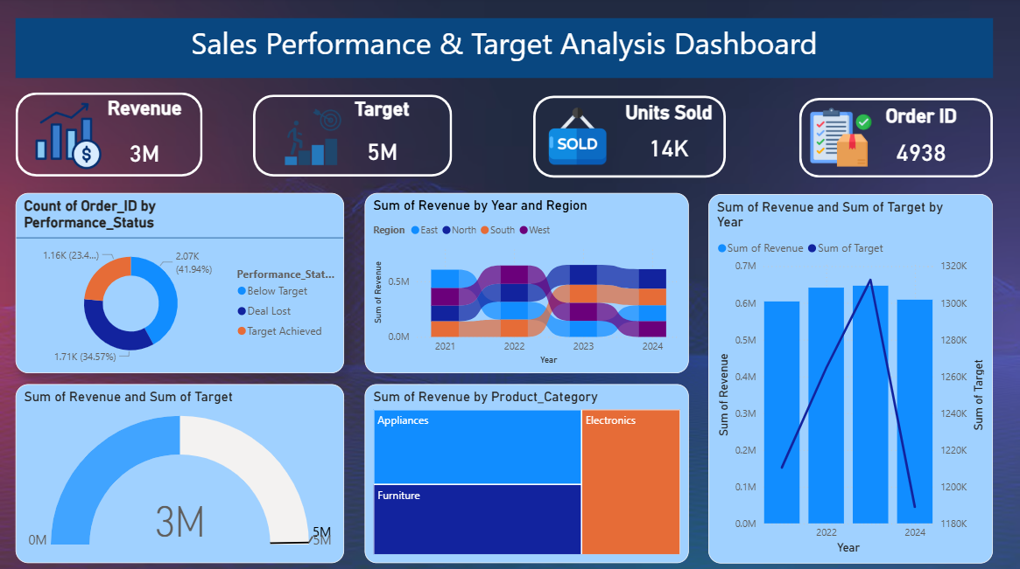

Slide 7
Chart Explanation
Donut Chart
The Logic: Created using a Custom M-Code script to calculate a new "Success Metric" from 5,000 records.
How it Works: It compares Revenue vs. Target for every row to categorize deals as Target Achieved, Below Target, or Deal Lost.
Business Insight: This is the "Efficiency Filter." It shows that even in high-revenue months, the company might be failing to hit its specific growth targets.
Ribbon Chart
The Logic: This tracks the performance ranking of Globalmart’s four regions over time
How it Works: The ribbons physically "cross over" each other when one region's revenue overtakes another.
Business Insight: It reveals market volatility. For example, if the "North" region drops from rank 1 to 3, it signals a need for immediate strategic intervention in that territory.

Slide 8
Gauge Chart
Actual Revenue ($3M$): Represented by the Blue Fill. This is the total sales achieved to
date.Total Scale ($5M$): The white end represents the Maximum Capacity or sales
ceiling.Insight: Provides a "Speedometer" view of performance. We have currently captured 60% of our total sales potential
Treemap Chart
The Logic: Breaks down the $3M$ revenue into Product Categories.
The Size: Larger rectangles represent the highest revenue
contributors.Insight: Instantly identifies the "Revenue Engines." It shows exactly which products (like Furniture or Tech) are driving the most profit.

Slide 9
Line and Clustered Column Chart
The Logic: Compares Total Revenue across different Geographic Regions (e.g., North, South, East, West).
The Visual: Uses vertical bars side-by-side to show the performance of each territory.
Business Insight: Identifies "Growth Hotspots." It shows which region is leading in sales and which ones are lagging behind.
Value: Helps management decide where to allocate more resources or where to launch new marketing campaigns to fix low performance.
Tools and Technology Used
Power BI Desktop – Visualization and Dashboard Creation
Kaggle – Dataset Source

Slide 10
Conclusion
The GlobalMart Dashboard successfully converts 5,000+ rows of data into a strategic roadmap, confirming $3 Million in actual revenue. This performance represents 60% of our total $5 Million capacity, providing a clear "health check" of our sales volume. By layering the Gauge and Treemap visuals, we’ve moved past basic reporting to identify the specific product categories and regions driving our growth.
This visibility allows management to shift from guesswork to data-driven decision-making, ensuring resources are focused on high-demand areas. Looking forward, the project’s future scope includes predictive forecasting and live data integration to anticipate market shifts in real-time. By bridging the current $2M gap with these insights, GlobalMart is positioned to optimize its supply chain and reach its maximum revenue potential. This dashboard provides the essential foundation for a more competitive and reactive business strategy.

